Slide 1
Python 3
Something Nice here
Joel Enrique Esparza Ramirez
Internet of Things

Slide 2
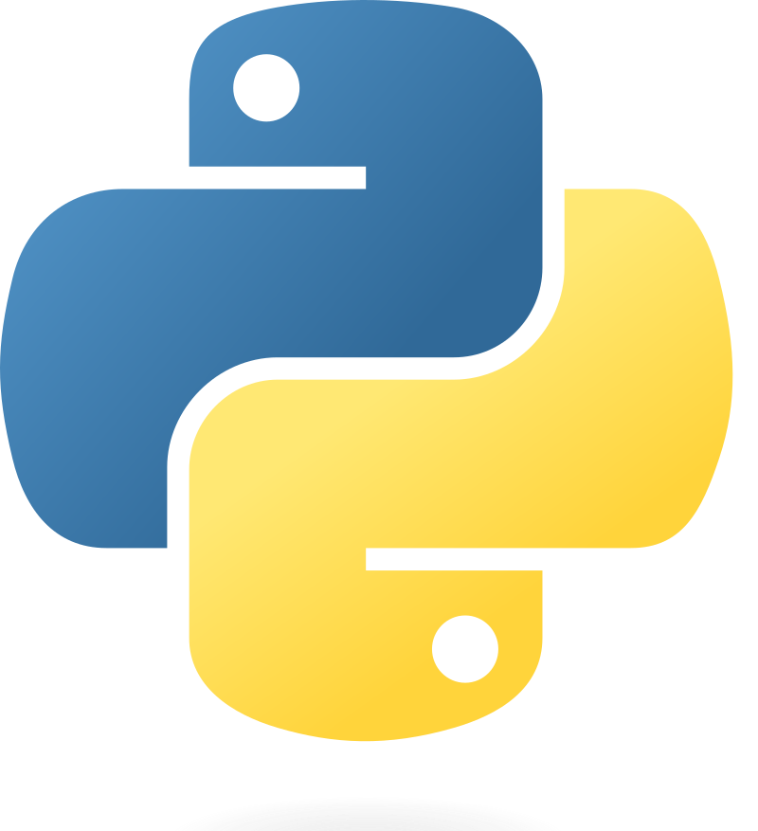
welcome

Slide 3
Introduction
Part 1

Slide 4
Python
Python is a high-level, interpreted programming language known for its simplicity and readability. It was created by Guido van Rossum and first released in 1991. Python's design philosophy emphasizes code readability with its use of significant indentation. Its language constructs and object-oriented approach aim to help programmers write clear, logical code for small and large-scale projects.

Slide 5
Interpreted Language
Python code is executed line by line, which makes debugging easier but may result in slower execution compared to compiled languages.

Slide 6
Dynamically Typed
Python does not require explicit declaration of variable types. The type is inferred at runtime, which adds flexibility but requires careful consideration to avoid type-related errors.

Slide 7
Multi-Paradigm
Supports different programming paradigms including procedural, object-oriented, and functional programming.

Slide 8
Extensive Standard Library
Comes with a large standard library that includes modules and packages for various functionalities, reducing the need for external libraries.

Slide 9
Cross-Platform Compatibility
Python programs can run on various operating systems without requiring changes to the code.

Slide 10
Indentation
Uses whitespace indentation to define code blocks, making the code visually structured and readable.

Slide 11
Open Source
Python is developed under an OSI-approved open-source license, making it freely usable and distributable, even for commercial use.

Slide 12
Strong Community
Has a large and active community, providing extensive support, documentation, and a vast array of third-party tools, libraries, and frameworks.

Slide 13
Applications
Widely used in web development, data science, artificial intelligence, scientific and numeric computing, software development, and system scripting.

Slide 14
HOW TO INSTALL PYTHON
https://www.python.org/downloads/

Slide 15
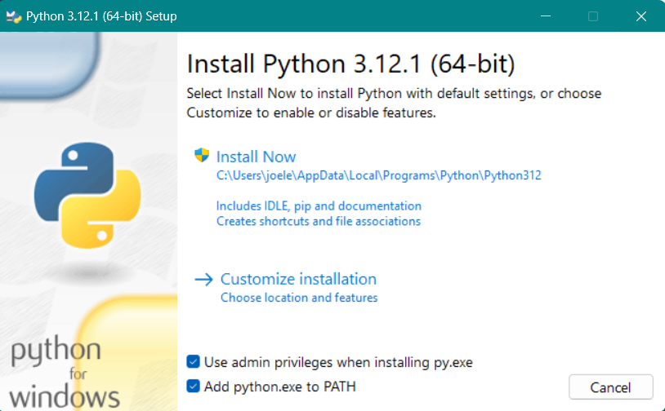

Slide 16
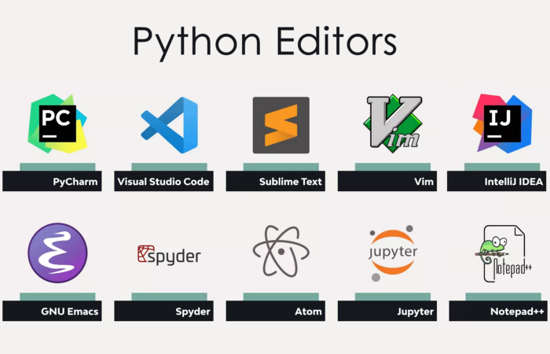
Install text editor

Slide 17

HELLO WORLD
Lecture 1

Slide 18
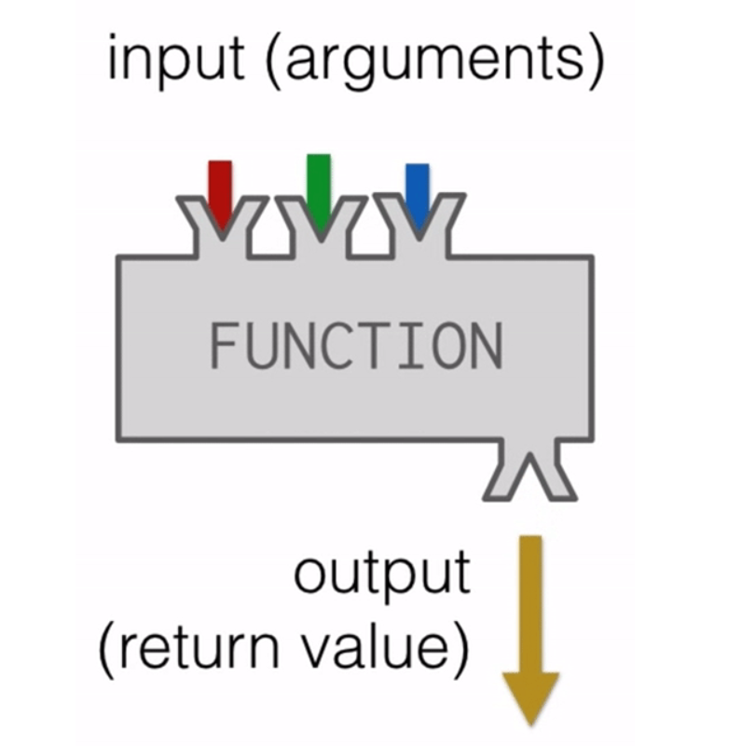


BUILT-IN FUNCTIONS

Slide 19
PART 1
Values and data types

Slide 20
Variables
A variable in Python is a reserved memory location to store values. In other words, a variable in a Python program gives data to the computer for processing.

Slide 21
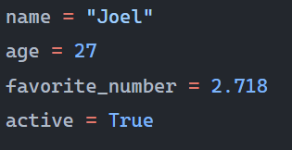
Assignment
Snake Case: Typically used for variable names. Example: my_variable.

Slide 22
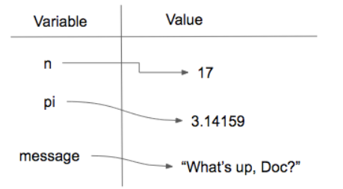

Slide 23
VARIABLES
Lecture 2

Slide 24
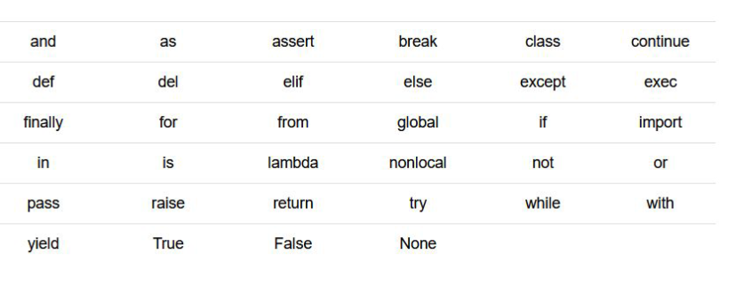
Exceptions

Slide 25
VALUES
INT
FLOAT
STRING
BOOLEAN

Slide 26
Type()
The type() function in Python is a built-in function that returns the type of an object. This means it tells you what class a variable or a value belongs to. The type() function is commonly used for debugging and development purposes, allowing developers to check the data types of variables and understand how to work with them effectively.

Slide 27
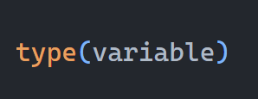

Slide 28
Values
Lecture 3

Slide 29
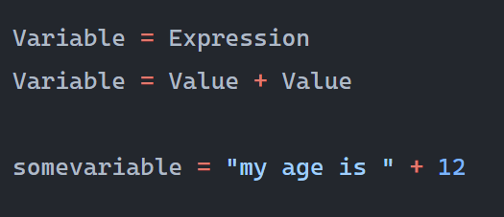
expressions

Slide 30
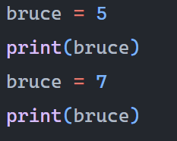
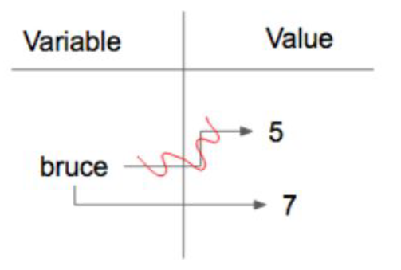
Reassignment

Slide 31
PART 1
Operators and Operands

Slide 32
Operators and Operands
In Python, operators are special symbols that carry out arithmetic or logical computation. The value(s) that the operator operates on are called operands.

Slide 33
Arithmetic Operators
+ Addition: Adds two operands. Ex: x + y
- Subtraction: Subtracts two operands. Ex: x - y
* Multiplication: Multiplies two operands. Ex: x * y
/ Division: Divides the first operand by the second. Ex: x / y

Slide 34
Arithmetic Operators
% Modulus: Returns the remainder when first operand is divided by the second. Ex: x % y
** Exponentiation: Raises the first operand to the power of the second. Ex: x ** y
// Floor division: Division that results into whole number adjusted to the left in the number line. Ex: x // y

Slide 35
Arithmetic Operators
Lecture 4

Slide 36
Exercise 1: Basic Arithmetic with Integers and Floats
Write a program that calculates the average of three numbers: an integer 15, a float 6.5, and another integer 22. Assign the result to a variable called average and print it out.

Slide 37
Exercise 2: String Concatenation and Repetition
Create a program that concatenates the following strings: "Python" and "3.8", separated by a space, and then repeat this concatenated string 3 times. Store the result in a variable called repeated_string and print it out.

Slide 38
Exercise 3: Mixing Strings and Numbers
Write a program that takes an integer variable age with a value of 30 and a string variable greeting with the value "Hello, I am ". Concatenate greeting with age to form a complete sentence. You will need to convert the integer to a string before concatenation. Print the result.

Slide 39
Comparison Operators
Compare the values on either sides of them and decide the relation among them. They are also called Relational operators.

Slide 40
Comparison Operators
== Equal to: True if both operands are equal. Ex: x == y
!= Not equal to: True if operands are not equal. Ex: x != y
> Greater than: True if left operand is greater than the right. Ex: x > y
< Less than: True if left operand is less than the right. Ex: x < y

Slide 41
Comparison Operators
>= Greater than or equal to: True if left operand is greater than or equal to the right. Ex: x >= y
<= Less than or equal to: True if left operand is less than or equal to the right. Ex: x <= y

Slide 42
Comparison Operators
These operators are fundamental in making decisions (control flow) in your code, allowing you to execute different blocks of code based on certain conditions. For instance, they are commonly used in if statements, loops, and other control structures to direct the flow of a program based on comparisons.

Slide 43
Comparison Operators
Lecture 5

Slide 44
Logical Operators
Used to combine conditional statements:
‘and’ Logical AND: True if both the operands are true. Ex: x and y
‘or’ Logical OR: True if either of the operands is true. Ex: x or y
‘not’ Logical NOT: True if operand is false (complements the operand). Ex: not x

Slide 45
Logical Operators
Lecture 6

Slide 46
Assignment Operators
Used to assign values to variables:
= Assign: Assigns value from right side operands to left side operand. Ex: x = y
+= Add AND: It adds right operand to the left operand and assign the result to left operand. Ex: x += y is equivalent to x = x + y

Slide 47
Assignment Operators
Lecture 7

Slide 48
PART 1
Type conversion functions

Slide 49
Type conversion functions
In Python, type conversion functions are used to convert one data type into another.
int() - Converts a value to an integer.
float() - Converts a value to a floating-point number.
str() - Converts a value to a string.

Slide 50
Type conversion functions
Lecture 8

Slide 51
Exercise 1: Converting Strings to Numbers
Instruction: You have the following string variables: a = "123" and b = "456.789". Convert a to an integer and b to a float, then perform addition on these numeric values.
Expected Output:
579.789

Slide 52
Exercise 2: Formatting Floats as Strings
Instruction: You have a float variable c = 123.456789. Convert this float to a string and prepend the string with the text "The value is: ".
Expected Output:
The value is: 123.456789

Slide 53
PART 1
String methods

Slide 54
Method
In Python, a method refers to a function that is associated with an object. Within the context of object-oriented programming (OOP), methods are functions that are defined inside a class and are meant to be called on instances of that class. These methods can perform operations with the attributes of our objects or execute operations related to the object's purpose.

Slide 55

String
Method

Slide 56
String methods
Python strings come with a variety of methods that allow you to perform operations on them. These methods can be used for transforming, searching, and modifying string data.

Slide 57
Case Conversion
str.capitalize(): Converts the first character to uppercase and the rest to lowercase.
str.upper(): Converts all characters to uppercase.
str.lower(): Converts all characters to lowercase.
str.title(): Converts the first character of each word to uppercase and the rest to lowercase.
str.swapcase(): Swaps the case of each character.

Slide 58
Case Conversion
Lecture 9

Slide 59
Checking Content
str.isdigit(): Returns True if all characters in the string are digits.
str.isalpha(): Returns True if all characters in the string are alphabetic.
str.isalnum(): Returns True if all characters in the string are alphanumeric.
str.isspace(): Returns True if all characters in the string are whitespace.
str.islower(): Returns True if all cased characters in the string are lowercase.
str.isupper(): Returns True if all cased characters in the string are uppercase.

Slide 60
Checking Content
Lecture 10

Slide 61
indexing
Introduction

Slide 62
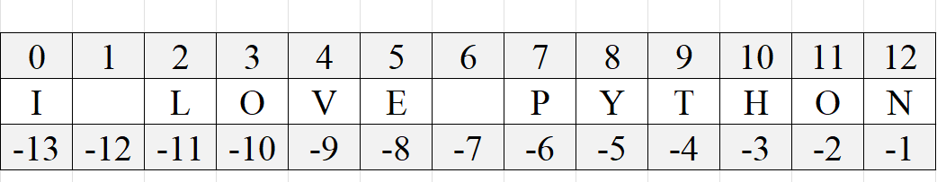

Slide 63
Searching and Replacing
str.find(sub[, start[, end]]): Returns the lowest index in the string where substring sub is found.
str.rfind(sub[, start[, end]]): Returns the highest index in the string where substring sub is found.
str.replace(old, new[, count]): Returns a string where all occurrences of old are replaced by new.

Slide 64
Searching and Replacing
str.rindex(sub[, start[, end]]): Like rfind(), but raises ValueError when the substring is not found.
str.replace(old, new[, count]): Returns a string where all occurrences of old are replaced by new.

Slide 65
Searching and Replacing
Lecture 11

Slide 66
Formatting
Formatting in Python involves creating strings that include variables in a readable and customizable way.

Slide 67
.format() Method
.format() Method: Introduced in Python 2.6, the .format() method offers more flexibility and functionality for string formatting. It supports positional and keyword arguments, alignment, width, and precision specifiers, and more.

Slide 68
F-strings
Introduced in Python 3.6, f-strings offer a concise and readable way to embed expressions inside string literals, using curly braces {}. The expressions inside the braces are evaluated at runtime, and then formatted using the format specifier (if provided).

Slide 69
Formatting
Lecture 12

Slide 70
LIST
Introduction

Slide 71
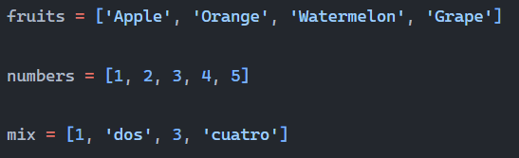
LIST

Slide 72
SPLIT METHOD
The split() method in Python is used to split a string into a list of substrings based on a specified delimiter. By default, if no delimiter is specified, the method splits the string using whitespace as the delimiter.

Slide 73
SPLIT
Lecture 13

Slide 74
Len function
The len() function in Python is used to find the length (the number of items) of an object. It can be applied to several object types, including strings, lists, tuples, dictionaries, sets, and other collections. The function returns an integer representing the number of items in the object.

Slide 75
INPUT
In Python, the input() function allows you to take user input from the keyboard as a string. It pauses the program's execution and waits for the user to type something, followed by pressing the Enter key. The function then reads the input as a string and can return it to the program.

Slide 76
INPUT
The input() function always returns a string. If you expect a different type (like an integer or float), you need to explicitly convert the input using type conversion functions like int() or float().

Slide 77
INPUT
Lecture 14

Slide 78
IF STATEMENT
The if statement in Python is used for conditional execution. It allows you to execute a block of code only if a specified condition is true. If the condition is false, the block of code will be skipped. You can also extend the if statement with elif (short for "else if") and else blocks to handle multiple conditions and provide an alternative execution path when the initial condition is false.

Slide 79
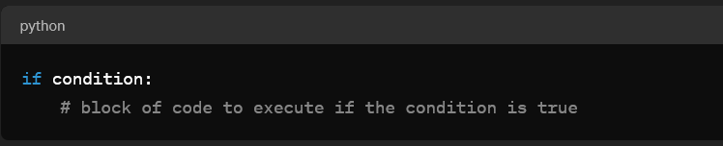
BASIC SYNTAX

Slide 80
IF
Lecture 15

Slide 81
FOR LOOP
The for loop in Python is a control flow statement that is used to iterate over a sequence (such as a list, tuple, dictionary, set, or string) or other iterable objects. Iterating over a sequence is called traversal. The for loop is often used when you have a block of code which you want to repeat a fixed number of times.

Slide 82
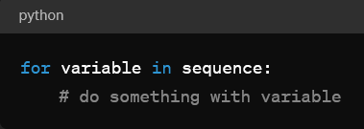
Basic Syntax
variable: This is the placeholder for each item in the sequence, taking on each value in it, one at a time.
sequence: This is the sequence you want to iterate over.

Slide 83
FOR
Lecture 16

Slide 84
Accumulator Pattern
One common programming “pattern” is to traverse a sequence, accumulating a value as we go, such as the sum-so-far or the maximum-so-far. That way, at the end of the traversal we have accumulated a single value, such as the total of all the items or the largest item.

Slide 85
Accumulator Pattern
The anatomy of the accumulation pattern includes:
initializing an “accumulator” variable to an initial value (such as 0 if accumulating a sum)
iterating (e.g., traversing the items in a sequence)
updating the accumulator variable on each iteration (i.e., when processing each item in the sequence)

Slide 86
FOR 2
Lecture 17

Slide 87
Slicing
Slicing in Python is a method used to extract parts of sequences such as strings, lists, tuples, and other iterable objects. It's a very flexible and powerful feature that allows you to retrieve sub-parts of sequences using a very concise syntax.

Slide 88
Slicing
Lecture 18

Slide 89

TEST
PART I

Slide 90
DATA STRUCTURES
Part 1I

Slide 91
LISTS
Lists in Python are versatile, dynamic arrays that can store elements of different data types. They are one of the most used data structures in Python due to their flexibility and ease of use. Lists are defined by square brackets [], with elements separated by commas.

Slide 92

Accessing List Elements
You access the elements of a list by referring to the index number. Indices in Python start at 0.

Slide 93

Slicing Lists
Lists can be sliced to obtain sublists, using the colon : operator.

Slide 94
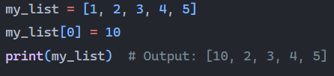
Modifying Lists
Lists are mutable, meaning their elements can be changed after the list has been created.

Slide 95
METHODS
Python lists come with a variety of methods that allow for efficient and convenient manipulation of list data.

Slide 96
LIST METHODS
Lecture 19

Slide 97
TUPLES
Tuples in Python are a type of data structure that can store a collection of items. They are like lists, but with a crucial difference: tuples are immutable. This means that once a tuple is created, its contents cannot be modified (you can't add, change, or remove elements from it).

Slide 98
Creation
Tuples are created by placing a sequence of values separated by commas within parentheses (). For example, my_tuple = (1, 2, 3) creates a tuple containing three integers. A single-element tuple must include a comma after the item, like (4,), to be distinguished from a simple parenthesis expression.

Slide 99
Accessing Elements
Elements within a tuple can be accessed using indexing, similar to lists. my_tuple[0] would access the first element in my_tuple.

Slide 100
Immutability
Unlike lists, tuples cannot be modified after they are created. Attempts to add, remove, or modify elements in a tuple will result in a TypeError.

Slide 101
METHODS
Tuples in Python, being immutable, have a limited set of methods available compared to lists. However, there are two important methods that are commonly used with tuples:
count(x)
index(x, [start, [end]])

Slide 102
TUPLES
Lecture 20

Slide 103
dictionaries
Dictionaries are collections of items that are stored in a pair of keys and values. Dictionaries are unordered, which means that the items do not have a defined order. They are mutable, allowing the modification of elements after the dictionary has been created. They are also dynamic, meaning they can grow or shrink as needed.

Slide 104
Creating a Dictionary
You can create a dictionary by placing a comma-separated list of key-value pairs within curly braces {}, with a colon : separating the keys from the values.

Slide 105

Accessing Dictionary Values
You access the values in a dictionary by using the keys as indexes.

Slide 106
Dict.
Lecture 21

Slide 107
Functions
Part III

Slide 108
functions
Functions are blocks of organized, reusable code that is used to perform a single, related action. Functions provide better modularity for your application and a high degree of code reusing.

Slide 109
Defining a Function
You can define a function using the def keyword, followed by a function name, parentheses (), and a colon :. The statements that form the body of the function start at the next line and must be indented.

Slide 110

EXAMPLE

Slide 111

Calling a Function
To call a function, use the function name followed by parentheses

Slide 112
Function
Lecture 22

Slide 113
Functions names
Use Lowercase Letters: Function names should be lowercase, with words separated by underscores as necessary to improve readability.
Descriptive Names: Choose a name that describes what the function does. For example, calculate_area is more descriptive than func1.

Slide 114
Functions names
Avoid Conflicts: Do not use names that are already taken by Python keywords or built-in functions unless you have a very good reason to do so.
Short but Descriptive: While names should be descriptive, they should also be as concise as possible without sacrificing clarity.

Slide 115
DOCSTRING
Docstrings in Python are string literals that appear right after the definition of a function, method, class, or module. They are used to document the purpose and usage of the code block they describe. Docstrings are accessible through the __doc__ attribute of the object they document and can be viewed using the help() function.

Slide 116
Syntax of Docstrings
Docstrings are created using triple quotes (""" or ''') so that they can span multiple lines. For a function or method, the docstring should be placed immediately following the definition line, before the code block starts.

Slide 117
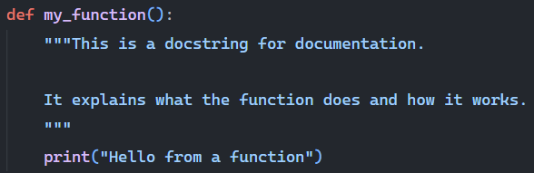
EXAMPLE

Slide 118
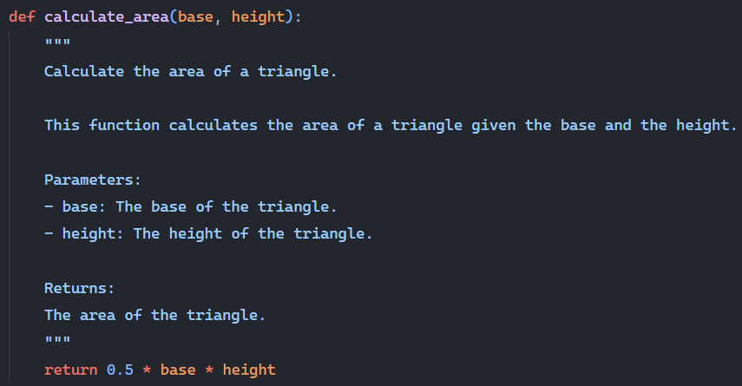
Example 2

Slide 119
Parameters
Parameters in functions are a fundamental concept in Python, allowing functions to accept input values at the time they are called. These parameters act as placeholders within the function definition and become variables that hold the values passed to the function when it is executed.

Slide 120
Defining Parameters
When you define a function, you specify parameters in the parentheses following the function name. These parameters are essentially variables that the function can use internally.

Slide 121
Function parameters
Lecture 23

Slide 122
Return
The return statement in Python is used to exit a function and pass back a value to where the function was called. This feature is what makes functions powerful and versatile in programming, allowing for the output of a function to be used elsewhere in your code. When a function reaches a return statement, the function terminates and optionally returns a value to the caller.

Slide 123
Function Return
Lecture 24

Slide 124
Function parameters
Lecture 25

Slide 125
CSV
CSV (Comma-Separated Values) files are a type of plain text file that uses specific structuring to arrange tabular data. Because it's a text format, it can be easily created, processed, and understood by humans and machines.

Slide 126
CSV
CSV file format is defined by rows, with each row representing a record. Within each row, columns are separated by commas, defining the fields of the record. The simplicity of this format makes it highly versatile and widely used for transferring data between different programs and environments. For instance, you can export or import CSV files between spreadsheet programs (like Microsoft Excel, Google Sheets), databases, and various software applications.

Slide 127
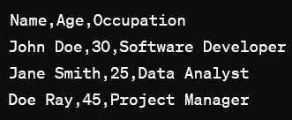
EXAMPLE

Slide 128
CSV READ
Lecture 26

Slide 129
CSV WRITE
Lecture 2y

Slide 130
Modules
Modules in Python are simply files containing Python code that define functions, classes, or variables, which you can include in your own Python programs. They serve as a way to organize code in a modular way, allowing you to reuse code across multiple projects without duplication.

Slide 131
MODULES
Lecture 28

Slide 132
__init__.py
The __init__.py file plays a crucial role in Python packages. Its presence in a directory indicates to Python that the directory should be treated as a package, making it possible to import modules from that directory into your scripts. This file can be empty or contain valid Python code that initializes the package

Slide 133
Web Development
Django: A high-level Python Web framework that encourages rapid development and clean, pragmatic design.
Flask: A lightweight WSGI web application framework designed to make getting started quick and easy, with the ability to scale up to complex applications.
Requests: An elegant and simple HTTP library for Python, built for human beings.

Slide 134
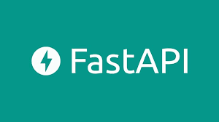
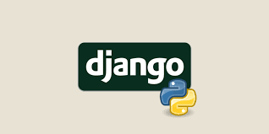
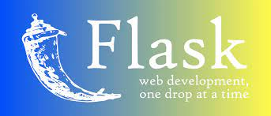

Slide 135
Data Analysis and Science
NumPy: A fundamental package for scientific computing with Python, providing support for large, multi-dimensional arrays and matrices, along with a collection of mathematical functions to operate on these arrays.
Pandas: A fast, powerful, flexible, and easy-to-use open-source data analysis and manipulation tool, built on top of the Python programming language.

Slide 136
Data Analysis and Science
SciPy: An open-source Python library used for scientific computing and technical computing, containing modules for optimization, integration, interpolation, eigenvalue problems, algebraic equations, differential equations, and others.
Matplotlib: A plotting library for the Python programming language and its numerical mathematics extension NumPy, providing an object-oriented API for embedding plots into applications.

Slide 137
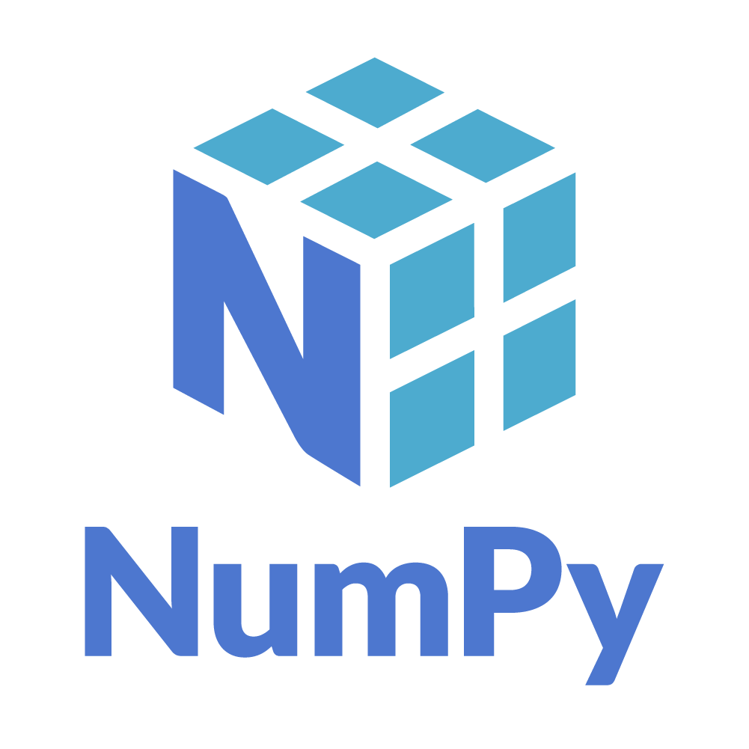
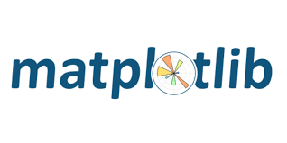



Slide 138
Machine Learning and Artificial Intelligence
Scikit-learn: A free software machine learning library for the Python programming language. It features various classification, regression, and clustering algorithms.
TensorFlow: An end-to-end open-source platform for machine learning designed by Google. It has a comprehensive, flexible ecosystem of tools, libraries, and community resources that lets researchers push the state-of-the-art in ML, and developers easily build and deploy ML-powered applications.
PyTorch: An open-source machine learning library based on the Torch library, used for applications such as computer vision and natural language processing, primarily developed by Facebook's AI Research lab.

Slide 139
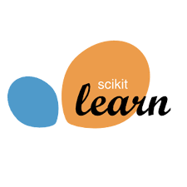
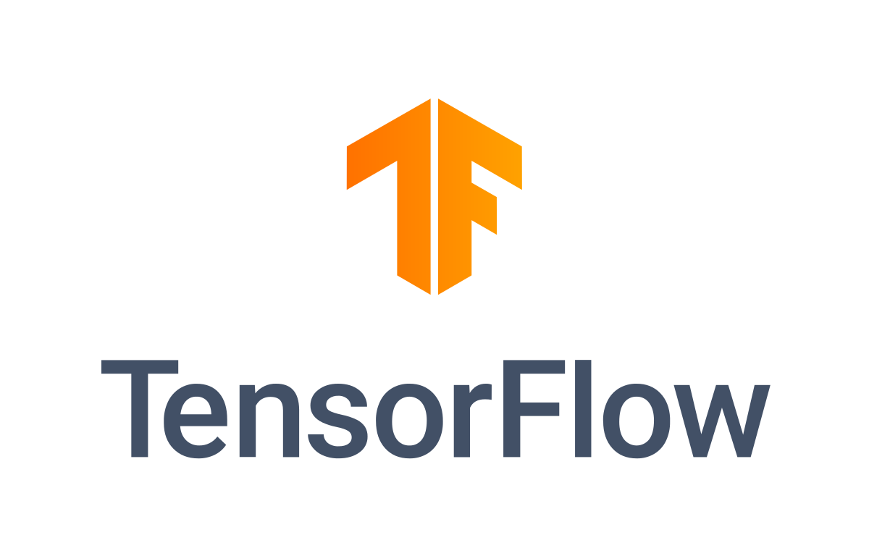
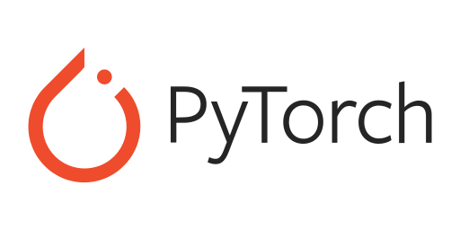

Slide 140
Automation and Scripting
Selenium: A portable framework for testing web applications, providing a playback tool for authoring functional tests without the need to learn a test scripting language.
Beautiful Soup: A library for pulling data out of HTML and XML files. It provides idiomatic ways of navigating, searching, and modifying the parse tree.

Slide 141

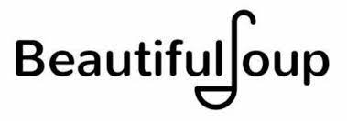

Slide 142
GUI Development
Tkinter: The standard GUI library for Python, providing a fast and easy way to create GUI applications.
PyQt: A set of Python bindings for The Qt Company’s Qt application framework, used to create graphical user interfaces as well as cross-platform applications that run on various software and hardware platforms.

Slide 143
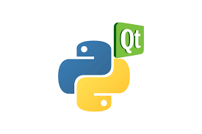
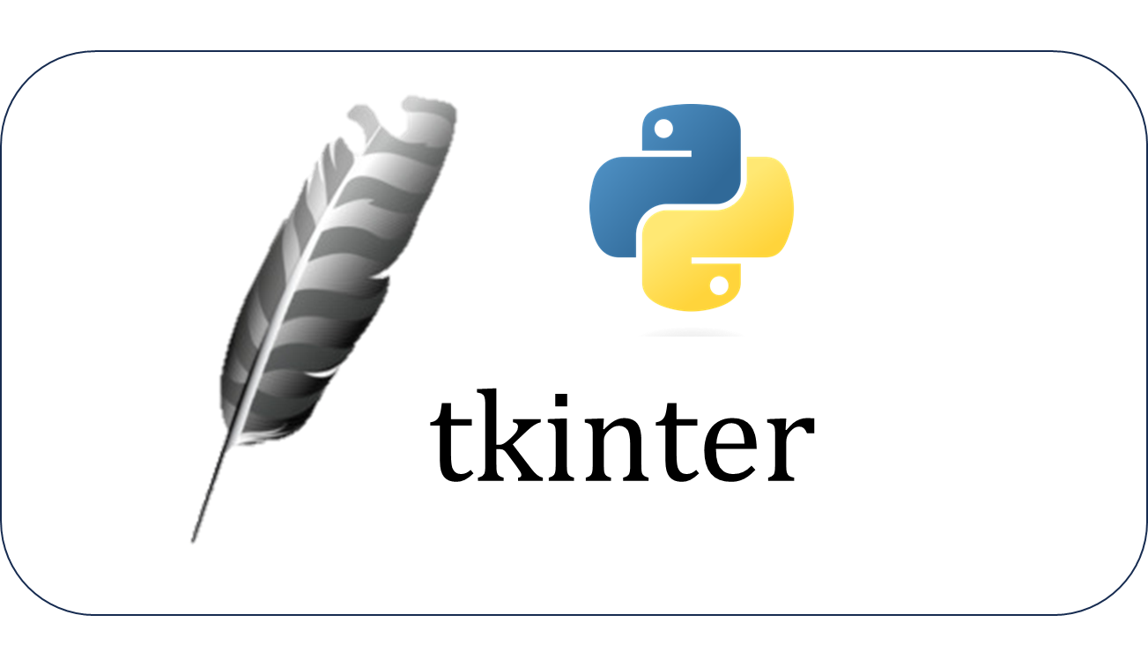

Slide 144
CLASSES
Part IV

Slide 145
object-oriented programming (OOP).
A class in Python provides a means of bundling data and functionality together. Creating a class involves defining a new type that can have attributes (data) and methods (functions associated with the class). This allows for creating objects (instances of a class) that can hold their own data and use the methods defined in the class.

Slide 146
CLASES
Lecture 29

Slide 147
OOP
Object-oriented programming has its roots in the 1960s, but it wasn’t until the mid 1980s that it became the main programming paradigm used in the creation of new software. It was developed as a way to handle the rapidly increasing size and complexity of software systems and to make it easier to modify these large and complex systems over time.

Slide 148
CLASS
A class in Python is a blueprint for creating objects. Classes encapsulate data for the object and methods to manipulate that data. A class is defined using the class keyword.

Slide 149
Objects
An object is an instance of a class. Once a class is defined, you can instantiate it to create an object. Each object can have unique attributes and behavior as defined by its class.

Slide 150
Attributes and Methods
Attributes are data stored inside an object or class, and methods are functions defined within a class that operate on its objects. Attributes represent the state of an object, while methods represent the behavior.

Slide 151
Inheritance
Inheritance allows a class to inherit attributes and methods from another class, known as the parent class. This promotes code reusability and creates a relationship where the child class can override or extend the functionality of the parent class.

Slide 152
Polymorphism
Polymorphism allows for the use of a single interface to represent different underlying forms (data types). In Python, this means that different classes can have methods with the same name, and those methods can be called in the same way even though they might perform different operations.

Slide 153
constructor
In object-oriented programming (OOP), a constructor is a special type of subroutine called to create an object. It prepares the new object for use, often accepting arguments that the constructor uses to set required member variables and allocate resources.

Slide 154
Methods
Methods in Python are functions that are defined inside a class and are used to define the behaviors of an object. Unlike standalone functions, methods are called on objects and can access and modify the state of the object to which they belong. This is done through the self parameter, which is a reference to the current instance of the class.

Slide 155
__str__
The __str__ method in Python is a special (dunder, for "double underscore") method that is meant to return a string representation of an object. When you define a __str__ method in a class, Python calls this method when you use the str() function on an instance of the class, or when you use the print() function to print an instance.

Slide 156
__str__
Lecture 31

Slide 157
Inheritance
Inheritance is a fundamental concept in Object-Oriented Programming (OOP) that allows a class to inherit attributes and methods from another class. The class that inherits is called the subclass (or derived class), and the class from which it inherits is called the superclass (or base class). Inheritance facilitates code reusability, allows for the creation of a hierarchical class structure, and supports the concept of polymorphism.

Slide 158
Inheritance
Lecture 32

Slide 159
ADVANCED FUNCTIONS
Part V

Slide 160
exceptions
In Python, try and except are used to handle exceptions, which are errors that occur during the execution of a program. This exception handling mechanism helps a program to respond appropriately to errors, instead of crashing unexpectedly.

Slide 161
EXPLAIN
try Block: You put the normal code that might cause an exception inside the try block.
except Block: If an exception occurs in the try block, the rest of the try block is skipped, and the code in the except block runs. If no exception occurs, the code in the except block doesn't run.

Slide 162
types of errors
In Python, there are several types of errors, broadly classified into two categories: syntax errors and exceptions.

Slide 163
1. Syntax Errors
Syntax errors occur when the parser detects an incorrect statement. These errors are also known as parsing errors. For example, missing a colon at the end of an if statement, or forgetting to close parentheses.

Slide 164
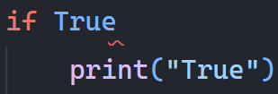
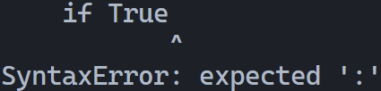
CODE
RESULT

Slide 165
2. Exceptions
Exceptions are errors that are detected during execution. They are not unconditionally fatal, which means they can be handled by the program.

Slide 166
Common Built-in Exceptions
ZeroDivisionError: Occurs when division or modulo by zero takes place.
NameError: Raised when a local or global name is not found.
TypeError: Happens when an operation or function is applied to an object of inappropriate type.
IndexError: Raised when a sequence subscript is out of range.
ValueError: Occurs when a function receives an argument that has the right type but an inappropriate value.

Slide 167
Common Built-in Exceptions
KeyError: Raised when a dictionary key is not found.
AttributeError: Occurs when an attribute reference or assignment fails.
FileNotFoundError: Raised when a file or directory is requested but doesn’t exist.
ImportError: Occurs when an import statement fails to find the module definition or when a from ... import fails to find a name that is to be imported.

Slide 168
EXCEPTIONS
Lecture 34

Slide 169
LAMBDA
Lambda functions in programming, particularly in Python, are small anonymous functions defined using the lambda keyword. They are often used for creating small, one-off functions without needing the formal definition of a regular function using def.

Slide 170
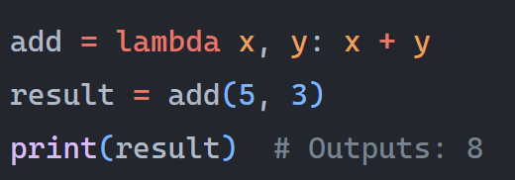

Slide 171
MAP
The map() function in Python is a built-in function used to apply a specific function to each item of an iterable (like a list or tuple) and returns a map object, which is an iterator.

Slide 172
Example 1: Squaring Numbers
Suppose you want to square each number in a list.
numbers = [1, 2, 3, 4, 5]

Slide 173
Example 2: Converting Strings to Upper Case
If you have a list of strings and you want to convert each of them to uppercase
names = ["alice", "bob", "charlie"]

Slide 174
Example 3: Using Multiple Iterables
a = [1, 2, 3]
b = [4, 5, 6]

Slide 175
MAP
Lecture 35

Slide 176
Filter
The filter() function in Python is another built-in function that constructs an iterator from elements of an iterable for which a function returns true. In other words, filter() takes a function and an iterable, and produces a new iterator with the elements from the iterable for which the function evaluates to True.

Slide 177
EXAMPLE 1
Write code to assign to the variable filter_testing all the elements in lst_check that have a w in them using filter.
lst_check = ['plums', 'watermelon', 'kiwi', 'strawberries', 'blueberries', 'peaches', 'apples', 'mangos', 'papaya’]
Expected: ['watermelon', 'kiwi', 'strawberries']

Slide 178
EXAMPLE 2
Using filter, filter lst so that it only contains words containing the letter “o”. Assign to variable lst2. Do not hardcode this.
lst = ["witch", "halloween", "pumpkin", "cat", "candy", "wagon", "moon"]
Expected: ['halloween', 'wagon', 'moon’]

Slide 179
List Comprehension
Python provides an alternative way to do map and filter operations, called a list comprehension. Many programmers find them easier to understand and write. List comprehensions are concise ways to create lists from other lists. The general syntax is:

Slide 180
List Comprehension
Lecture 35

Slide 181
Example
Write code to assign to the variable compri all the values of the key name in any of the sub-dictionaries in the dictionary tester. Do this using a list comprehension.
tester = {'info': [{"name": "Lauren", 'class standing': 'Junior', 'major': "Information Science"},{'name': 'Ayo', 'class standing': "Bachelor's", 'major': 'Information Science'}, {'name': 'Kathryn', 'class standing': 'Senior', 'major': 'Sociology'}, {'name': 'Nick', 'class standing': 'Junior', 'major': 'Computer Science'}, {'name': 'Gladys', 'class standing': 'Sophomore', 'major': 'History'}, {'name': 'Adam', 'major': 'Violin Performance', 'class standing': 'Senior'}]}

Slide 182
ZIP
The zip() function in Python is a built-in function that allows you to iterate over multiple iterables (like lists, tuples, or dictionaries) in parallel. It takes multiple iterables as input and returns an iterator that aggregates elements from each of the iterables. Each item returned by zip() is a tuple containing one element from each of the iterables.

